Slide 1
Chapter 13 The Stock Market

Slide 2
Financial System Overview (2)
Financial Markets
Financial Institutions
Bond Market (3,5,12)
Stock Market (13,6)
Money Market (11)
Mortgage Market (14)
Why Exists (7)
Banking Industry (19)
Mutual Fund Industry(20)
Hedging with Financial Derivatives (24)

Slide 3
Chapter Outline
Investing in Stocks
Computing the Price of Common Stock
How the Market Sets Security Prices
Errors in Valuation
Stock Market Index

Slide 4
Investing in Stocks
Represents ownership in a firm
Earn a return in two ways
Price of the stock rises over time
Dividends are paid to the stockholder
Stockholders have claim on all assets
Right to vote for directors and on certain issues
Two types
Common stock
Right to vote | Receive dividends
Preferred stock
Receive a fixed dividend | Do not usually vote

Slide 5
The Primary Market for Common Stocks
An IPO involves several steps.
Company appoints investment banking firms to arrange financing.
Investment banker designs the stock issue and arranges for underwriting (firm commitment) or best efforts (no firm commitment).
Company prepares a prospectus and submits it to the Securities and Exchange Commission (SEC) for approval. Investment banker circulates preliminary prospectus (red herring).
Upon obtaining SEC approval, company finalizes prospectus.
Underwriters place announcements (tombstones) in newspapers and begin selling shares.
SEO: seasoned equity offering, firms raise equity capital in a subsequent issuing of some shares to public

Slide 6
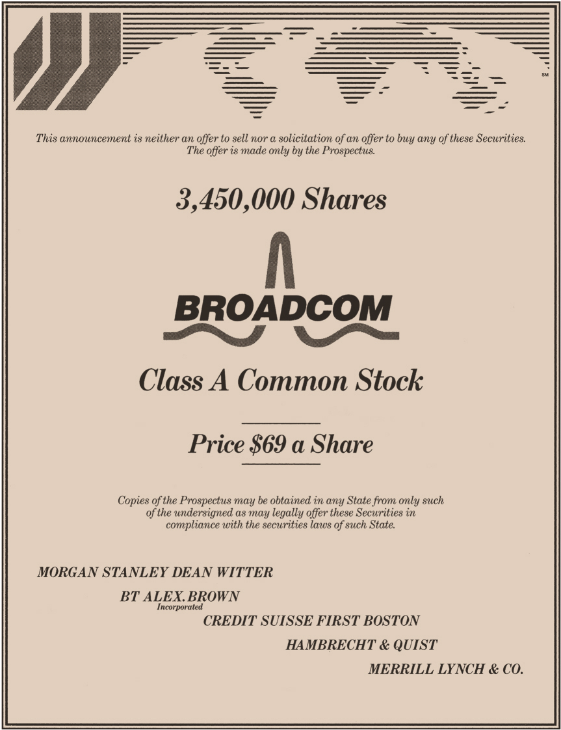
IPO Tombstone

Slide 7
Issuance of Stock in the Primary Market
Stocks Stocks
Issuing Investment Investors
Corporation Banks
Funds Funds
Investment bank conducts primary market sale of stock
firm commitment underwriting
Investment banks take the risk
Guarantees corporation a fixed price
Earn from the spread of the price
best efforts underwriting
No guarantee to issuer, acts more as a placing or distribution agent
No risk for the investment banks
Charge some fee from the issuing firm

Slide 8
Puzzles on Initial Public offerings
Evidence of underpricing (high initial returns)
The short run underpricing refers to the price run up of the IPO on the first day trading. It is also known as the initial return of first-day return of the IPO.
Long-term performance
Ritter (1991) and Loughran and Ritter (1995) argue that the long-run performance of IPOs is worse than that of the overall market or that of the firms with the matched size and age.
http://www.aastocks.com/en/stocks/market/ipo/listedipo.aspx?s=3&o=0&page=1

Slide 9
Secondary Markets Overview
Secondary Market
The market where investors constantly appraise the value of companies by trading previously issued securities. An investor can trade:
Directly with other investors.
Indirectly through a broker who arranges transactions for others.
Directly with a dealer who buys and sells securities from inventory.

Slide 10
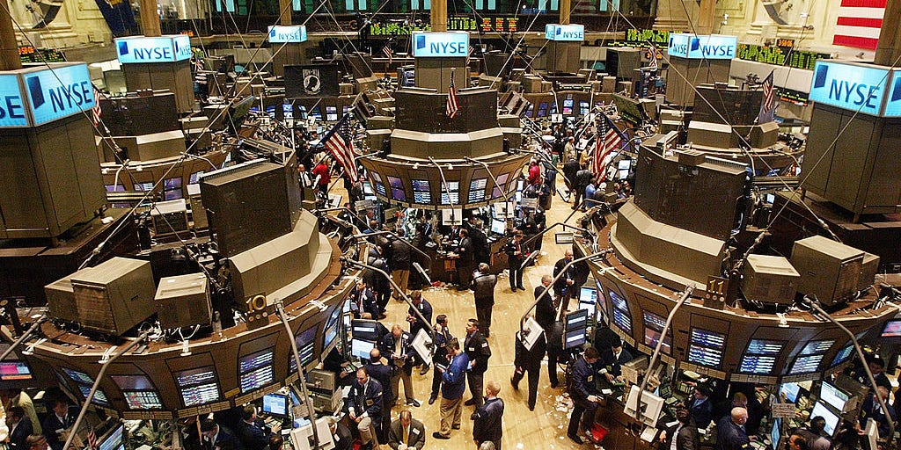
Investing in Stocks: How Stocks are Sold
Organized exchanges
NYSE is best known, with daily volume around 4 billion shares, with peaks at 7 billion.
Others include the ASE (US), and Nikkei, LSE, DAX (international)
Listing requirements exclude small firms
substantial earnings (>$10 million per year) and market value (>$100 million market value).

Slide 11
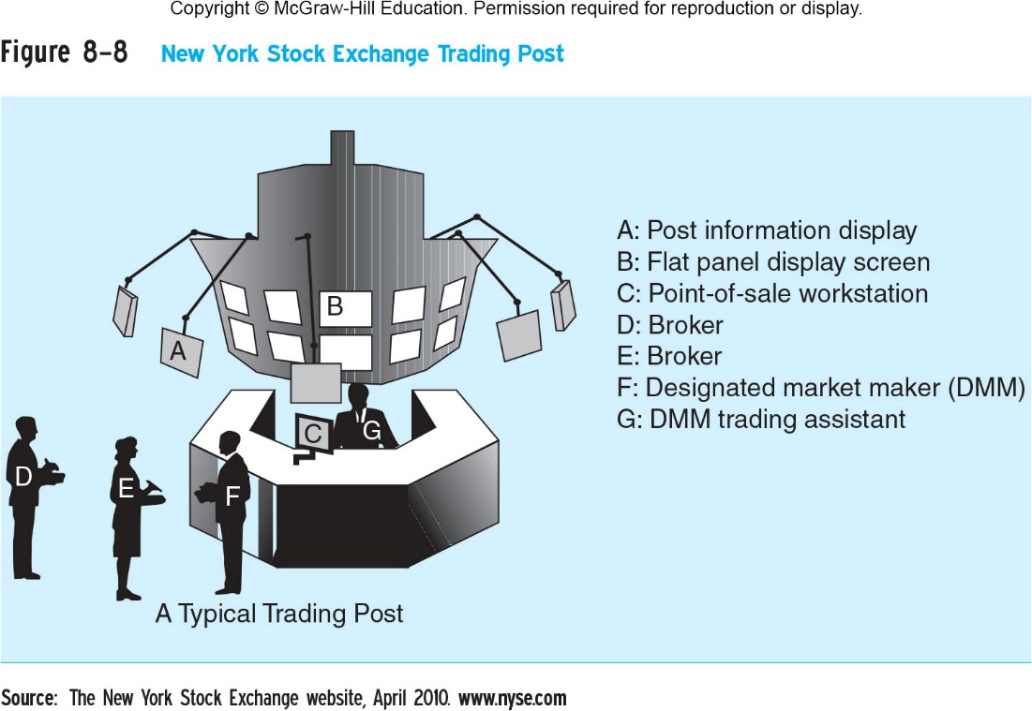

Slide 12
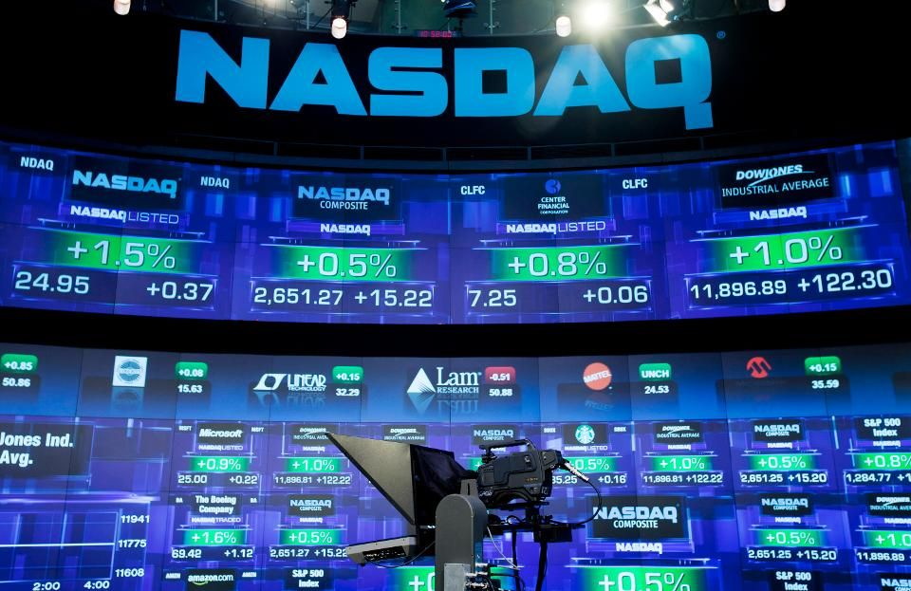
Investing in Stocks: How Stocks are Sold
Over-the-counter markets
Best example is NASDAQ
Dealers stand ready to make a market
Today, about 3,000 different securities are listed on NASDAQ.
Important market for thinly-traded securities—securities that don’t trade very often. Without a dealer ready to make a market, the equity would be difficult to trade.

Slide 13
Investing in Stocks: Organized vs. OTC
Organized exchanges (e.g., NYSE)
Auction markets with floor specialists
25% of trades are filled directly by specialist
Remaining trades are filled through SuperDOT
Over-the-counter markets (e.g., NASDAQ)
Multiple market makers set bid and ask prices
Multiple dealers for any given security
They each enter their bid and ask quotes. Once a trade has been executed, they may enter a new bid and ask quote.
Important to the economy in that they ensure there is continuous liquidity for every stock, even those with little transaction volume.

Slide 14
Investing in Stocks: ECNs
Alternative trading system (ATS)
ECNs (electronic communication networks) allow brokers and traders to trade without the need of the middleman.
ECNs are computer-based systems that display the best available bid and ask quotes from multiple market participants, and then automatically match and execute orders.
They provide:
Transparency: everyone can see unfilled orders
Cost reduction: smaller spreads
Faster execution
After-hours trading

Slide 15
Investing in Stocks: ECNs
ECNs are not without their drawbacks:
Don’t work as well with thinly-traded stocks
ECNs require there to be a seller to match against each buyer and vice versa.
Major exchanges are fighting ECNs, with an uncertain outcome
Expanding their automatic trading systems
Switch from live auction format (Open-outcry trading) to Electronic trading.

Slide 16
Investing in Stocks: Dark Pool
Alternative trading system (ATS)
A dark pool is a private financial forum or exchange for trading securities.
Allow investors to trade without exposure until after the trade has been executed.
Non-exchange trading accounting for about 40% of all U.S. stock trades in 2014 (15% from Dark pools).
They are mostly used by institutional investors for block trades involving a large number of securities.
As of April 2014, there were 45 dark pools in the U.S.
Bloomberg LP owns the dark pool Bloomberg Tradebook
http://www.investopedia.com/articles/markets/050614/introduction-dark-pools.asp

Slide 17
Chapter Outline
Investing in Stocks
Computing the Price of Common Stock
How the Market Sets Security Prices
Errors in Valuation
Stock Market Index
ADRs

Slide 18
Computing the Price of Common Stock
Valuing common stock is, in theory, no different from valuing debt securities:
determine the cash flows
discount them to the present
We will review four different methods for valuing stock, each with its advantages and drawbacks.
One-Period Valuation Model
Generalized Dividend Valuation Model
Gordon Growth Model
Price-Earning (PE) Valuation Method

Slide 19
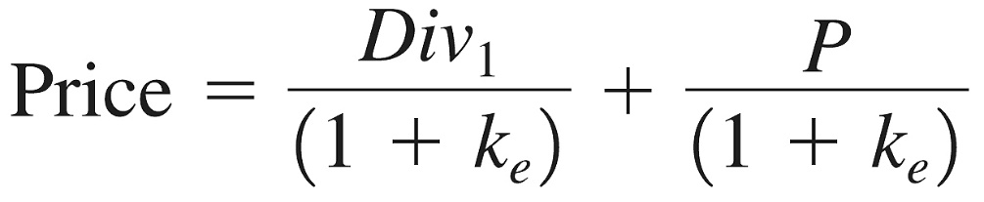
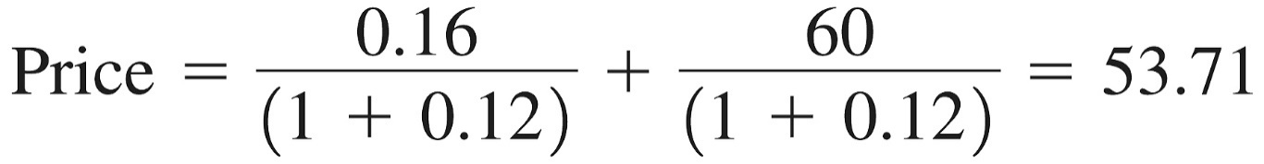
Computing the Price of Common Stock: The One-Period Valuation Model
Simplest model, just taking using the expected dividend and price over the next year.
What is the price for a stock with an expected dividend and price next year of $0.16 and $60, respectively? Use a 12% discount rate.

Slide 20
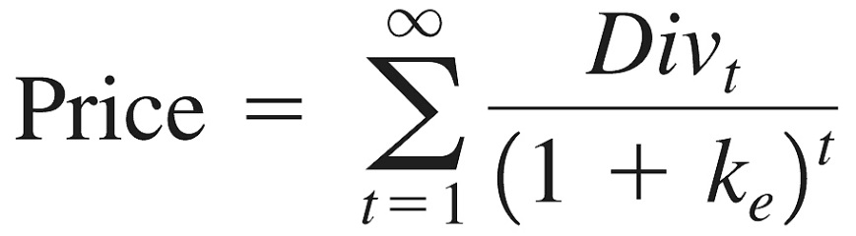
Computing the Price of Common Stock: The Generalized Dividend Valuation Model
Most general model, but the infinite sum may not converge.
Rather than worry about computational problems, we use a simpler version, known as the Gordon growth model.

Slide 21
Estimating Dividends: Special Cases
Constant dividend
The firm will pay a constant dividend forever
This is like preferred stock
The price is computed using the perpetuity formula
Constant dividend growth
The firm will increase the dividend by a constant percent every period
Supernormal growth
Dividend growth is not consistent initially, but settles down to constant growth eventually

Slide 22

http://www.mtr.com.hk/chi/investrelation/financialinfo.php
Average Dividend growth 3%(2001-2007)

Slide 23
Generalized formula
No matter how high the stock price is in the very distant future, its present value is essentially zero
If T →∞

Slide 24
Remarks
P₀ is the ex-dividend price of the stock
The stock price does not depend on how long an investor is going to keep the stock.
We implicitly assume that corporations will not go bankrupt in the future.
Why are shares of stock in companies that currently pay no dividends traded at positive prices? For example, internet stocks.
The hope of future dividends

Slide 25
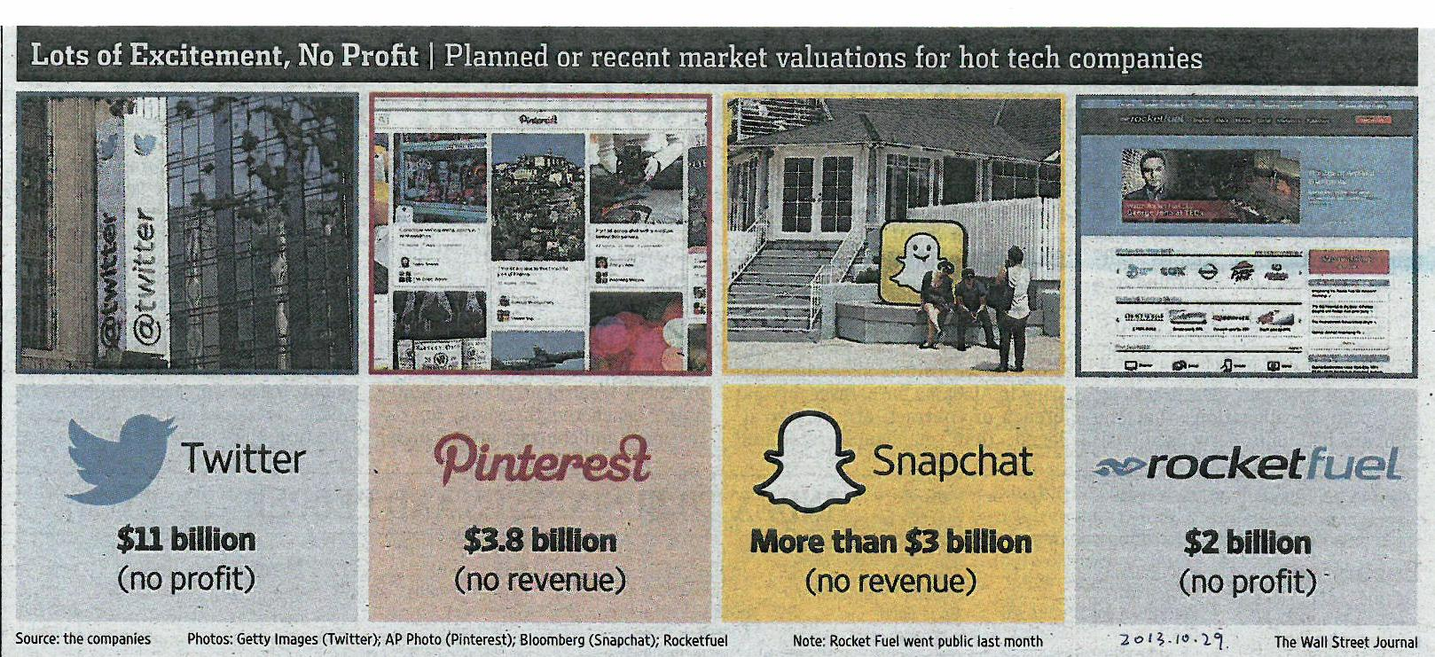

Slide 26
Constant Growth
Assume that dividends will grow at a constant rate, g, forever
…

Slide 27

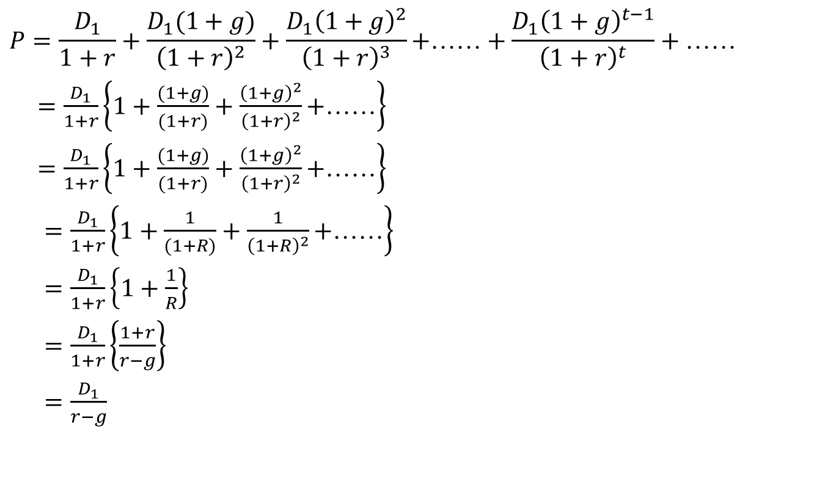
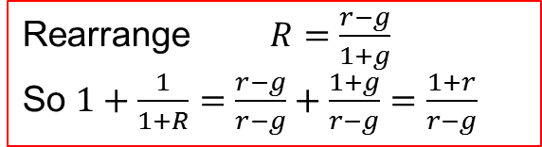
Stock Valuation (continued)
$$P=\frac{D_{1}}{1+r}+\frac{D_{1}(1+g)}{{\left(1+r\right)}^{2}}+\frac{D_{1}{\left(1+g\right)}^{2}}{{\left(1+r\right)}^{3}}\text{+}\text{……}+\frac{D_{1}{\left(1+g\right)}^{t−1}}{{\left(1+r\right)}^{t}}+\text{……}$$
$=\frac{D_{1}}{1+r}\left\{1+\frac{(1+g)}{(1+r)}+\frac{{\left(1+g\right)}^{2}}{{\left(1+r\right)}^{2}}\text{+}\text{……}\right\}$
$=\frac{D_{1}}{1+r}\left\{1+\frac{(1+g)}{(1+r)}+\frac{{\left(1+g\right)}^{2}}{{\left(1+r\right)}^{2}}\text{+}\text{……}\right\}$
$=\frac{D_{1}}{1+r}\left\{1+\frac{1}{(1+R)}+\frac{1}{{\left(1+R\right)}^{2}}\text{+}\text{……}\right\}$
$=\frac{D_{1}}{1+r}\left\{1+\frac{1}{R}\right\}$
$=\frac{D_{1}}{1+r}\left\{\frac{1+r}{r−g}\right\}$
$=\frac{D_{1}}{r−g}$
Define R such that $\frac{1}{1+R}=\frac{1+g}{1+r}$
PV of a perpetuity= 1/ R
Rearrange $R=\frac{r−g}{1+g}$
So $1+\frac{1}{1+R}=\frac{r−g}{r−g}+\frac{1+g}{r−g}=\frac{1+r}{r−g}$

Slide 28
Computing the Price of Common Stock: The Gordon Growth Model
The model is useful, with the following assumptions:
Dividends do, indeed, grow at a constant rate forever
How can g ever be assumed to be constant?
lies in the competitive equilibrium.
Firms will often attempt to manage their dividend policy so that there is a reasonably constant growth in dividends.
The growth rate of dividends, g, is less than the required return on the equity, r.
How can we assume that r > g ?
In short-run, g maybe greater than r.
In equilibrium, high returns on investment will attract capital, which will ensure that in the succeeding periods, higher returns cannot be earned without taking greater risk.
But taking greater risk will increase r, so g can not be increased without raising r.

Slide 29
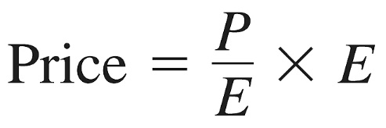
Computing the Price of Common Stock: Price-Earning (PE) Valuation Method
The price earnings ratio (PE) is a widely watched measure of much the market is willing to pay for $1.00 of earnings from the firms.
If the industry PE ratio for a firm is 16, what is the current stock price for a firm with earnings for $1.13 / share?
Answer:
Price = 16 × $1.13 = $18.08

Slide 30
Chapter Outline
Investing in Stocks
Computing the Price of Common Stock
How the Market Sets Security Prices
Errors in Valuation
Stock Market Index
ADRs

Slide 31
How the Market Sets Security Prices
Generally speaking, prices are set in competitive markets as the price set by the buyer willing to pay the most for an item.
The buyer willing to pay the most for an asset is usually the buyer who can make the best use of the asset.
Superior information can play an important role.

Slide 32
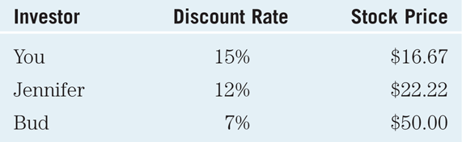
How the Market Sets Security Prices
Consider the following three valuations for a stock with certain dividends but different perceived risk:
Bud, who perceives the lowest risk, is willing to pay the most and will determine the “market” price.

Slide 33
Errors in Valuation
Although the pricing models are useful, market participants frequently encounter problems in using them. Any of these can have a significant impact on price in the Gordon model.
Problems with Estimating Growth (same as Problems with Forecasting Dividends)
Problems with Estimating Risk

Slide 34
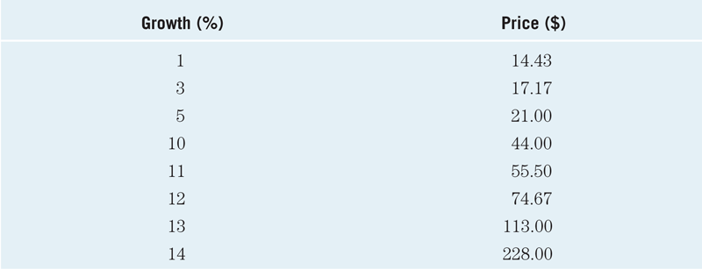
Errors in Valuation: Dividend growth rates
Table 13.1 Stock Prices for a Security with D₀ = $2.00, r = 15%, and Constant Growth Rates as Listed

Slide 35
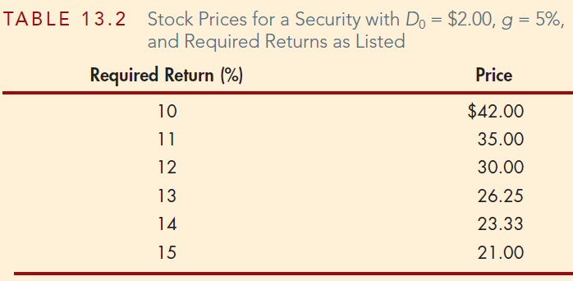
Errors in Valuation: Required returns

Slide 36
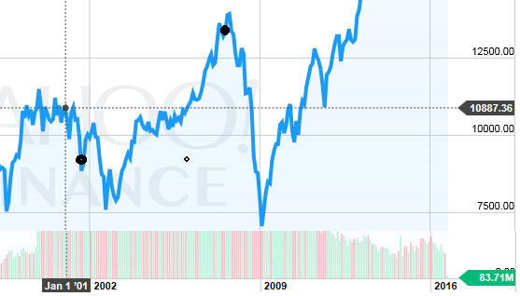
Errors in Valuation
Security valuation is not an exact science!
Considering different growth rates, required rates, etc., is important in determining if a stock is a good value as an investment.
DJIA

Slide 37
Case: 9/11, Enron and the Market
Both 9/11 and the Enron scandal were events in 2001.
Both should lower “g” in the Gordon Growth model - driving down prices.
Also impacts r - higher uncertainty increases this value, again lowering prices.
We did observe in both cases that prices in the market fell. And subsequently rebounded as confidence in US markets returned.

Slide 38
Case: The 2007–2009 Financial Crisis and the Stock Market
The financial crisis, which started in August 2007, was the start of one of the worst bear markets.
The crisis lowered “g” in the Gordon Growth model - driving down prices.
Also impacts r - higher uncertainty increases this value, again lowering prices.
The expectations were still optimistic at the start of the crisis. But, as the reality of the severity of the crisis was understood, prices plummeted.

Slide 39
Chapter Outline
Investing in Stocks
Computing the Price of Common Stock
How the Market Sets Security Prices
Errors in Valuation
Stock Market Index

Slide 40
Stock Market Indexes
Stock market indexes are frequently used to monitor the behavior of a groups of stocks.
Major indexes include the Dow Jones Industrial Average (price-weighted), the S&P 500 (value-weighted), and the NASDAQ composite (value-weighted).

Slide 41
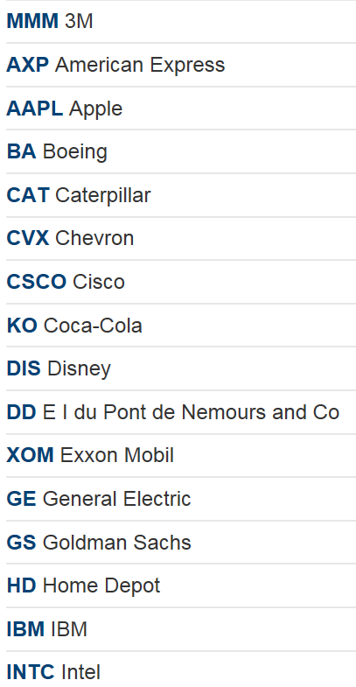
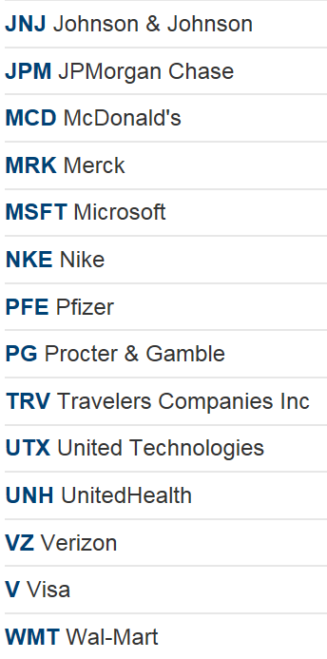
The Thirty Companies That Make Up the Dow Jones Industrial Average
http://money.cnn.com/data/dow30/

Slide 42
Stock Market Indexes
$1.00 invested in the DJIA back in 1980 (DJIA was around 800) would have grown to about $16.40 in 2012 (Dow closed year at 13,104). This represented an annual growth rate around 8.8%.
Averaging procedure is adjusted whenever a stock splits, pays a stock dividend of more than 10%, or when one company is replaced by another.

Slide 43
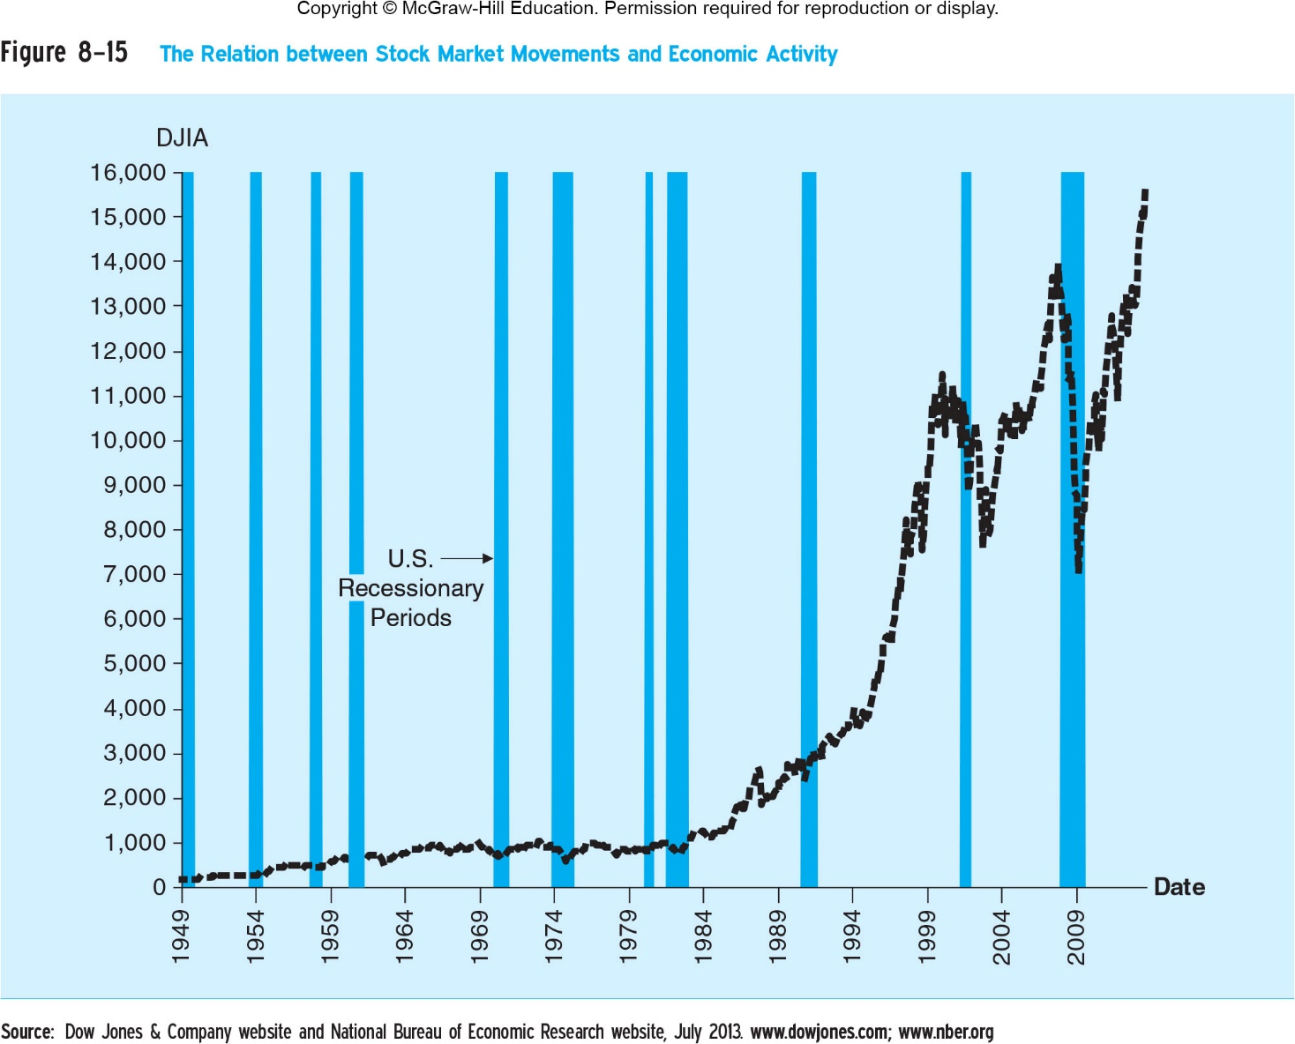

Slide 44
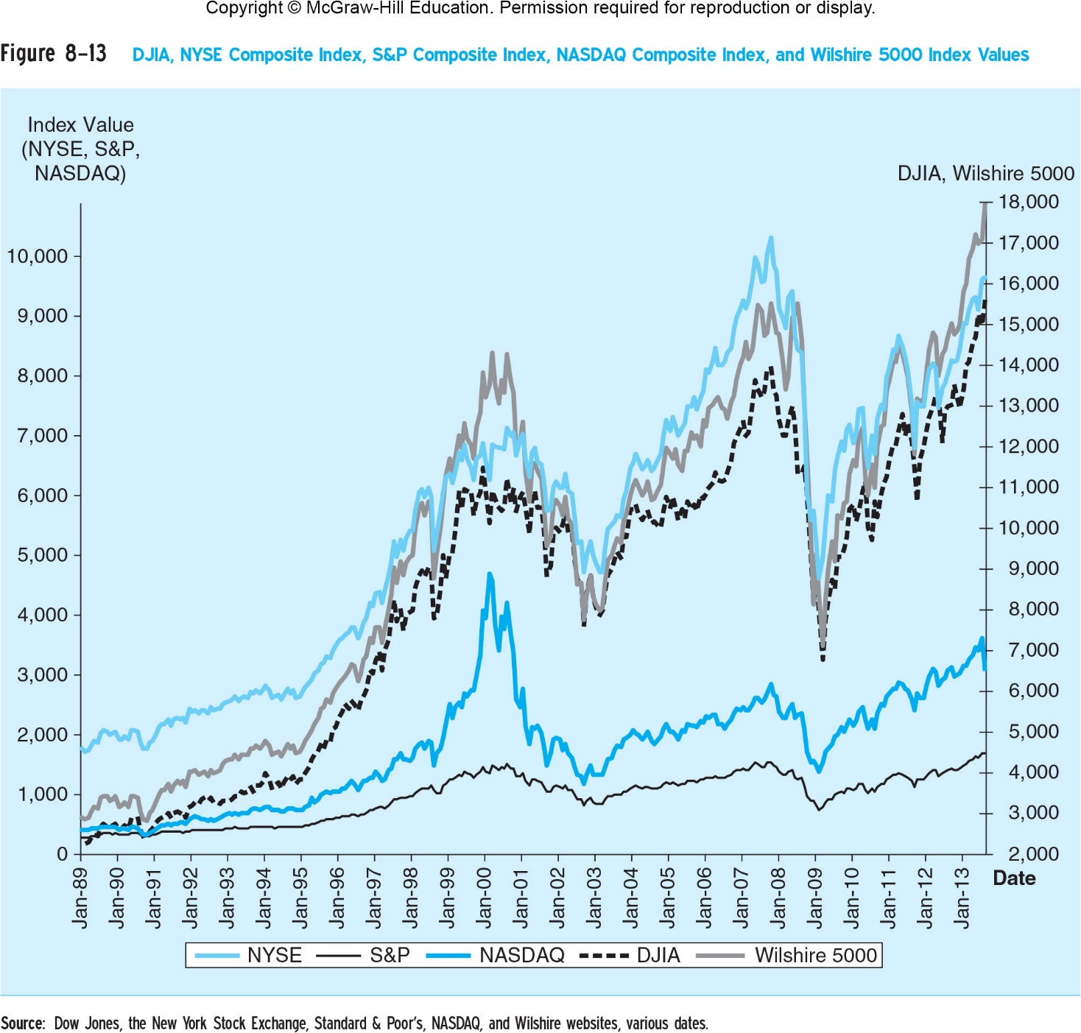

Slide 45
Summary of this Chapter
Investing in Stocks
Computing the Price of Common Stock
How the Market Sets Security Prices
Errors in Valuation
Stock Market Index

